Slide 1
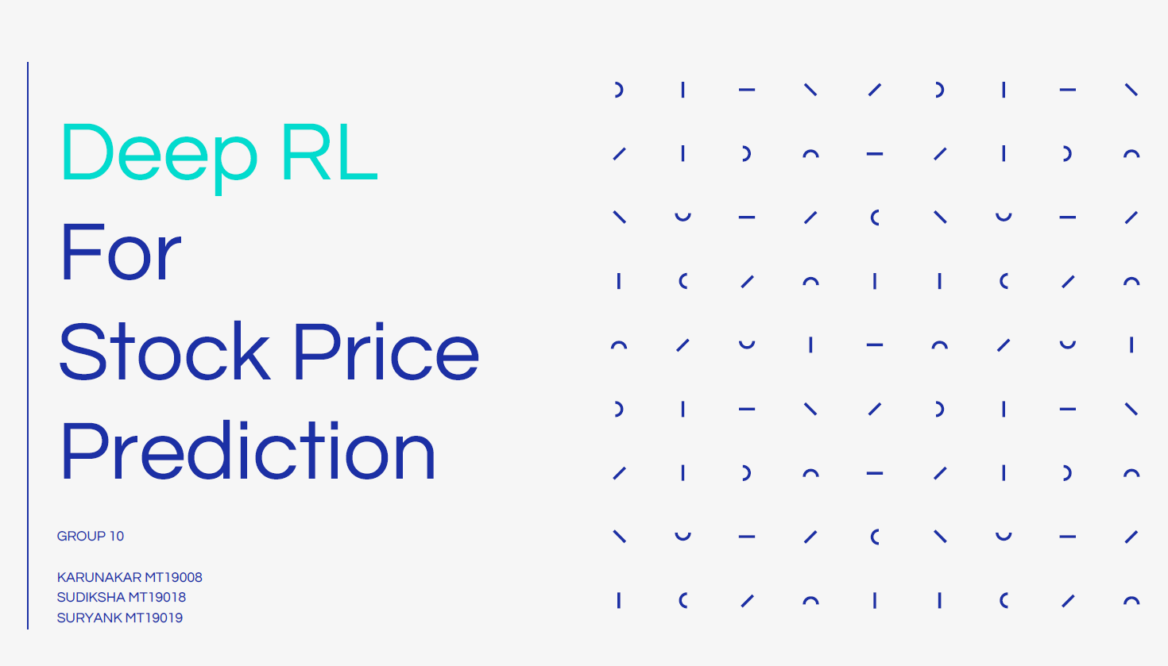

Slide 2
Project Introduction and Goals
To create an automated trading model for guidance in a stock market setting.
The aim is to maximize the profit given the state of the stock prices and a brief history.
The agent receives time series data, which describes the stock proceedings on a given time.
The agent may choose to hold, sell or buy based on the price and the our model calculates the profit.
We formulate our trading goal as a maximization problem.

Slide 3
Dataset
We use the YNDX stock market data for this problem statement.
The files contains time series proceedings with a tuple of values: open, high, low and close. Each of which denote stock price at a certain event.
The open price is the price at the beginning of the interval, high is the maximum price during the interval, low is the minimum price, and the close price is the last price of the time interval.
We have over 1.2 million entries of data to train upon.

Slide 4
Baseline Paper
Paper Title: Application of Deep Reinforcement Learning on Automated Stock Trading
Link: Source
Approach: The paper implements DQN and DRQN with Experience Replay to attempt the same problem statement.

Slide 5
BaseLine Model
DQN with experience replay
Deep Q-learning is a style of Q-learning with the Q-table replaced with a deep neural network. The Main idea of deep Q-learning is to use a neural network to approximate the Q-function.
The baseline implements a DQN with 4 layers (including the input layer) with 20, 10, 10 and 3 number of hidden units per layer.
We implemented this said architecture of DQN with experience replay on the dataset mentioned earlier and compared performance with Dueling DQN.

Slide 6
Our Model
DDQN(Dueling Deep Q Networks)
A simple feed-forward network with three layers followed by two fully connected layers to output Q values.
We separate the estimator to two different neural networks, and then aggregate both.
Architecture: (512 * 512) * (512, 1) for the value network and (512 * 512) * (512, 3) for the surplus network. Total 3 layers including the input.
Contains less depth than the baseline but more width.

Slide 7
Novelty
Two Environment Setups
Setup A:
States: Last 10 interval stock records with current one.
Actions: Buy, Sell or Hold.
Rewards: Percentage system. Reward is seen as positive percentage or negative percentage of the closing cost with respect to the opening cost.
This system of rewards allows the model to learn about different volumed, and different scope of stocks in a similar fashion

Slide 8
Novelty
Two Environment Setups
Setup B:
States: Last 10 interval stock records with current one.
Actions: Buy, Sell or Hold.
Rewards: Magnitude Differing Reward System. Reward is seen as positive or negative difference between the opening cost and the closing cost.
This system of rewards allows the model to learn about real world meaning of integers and mimic real world patterns.
People generally choose to sell/buy after stock hits a certain whole integer. These behaviors can be learned by the agent now.

Slide 9
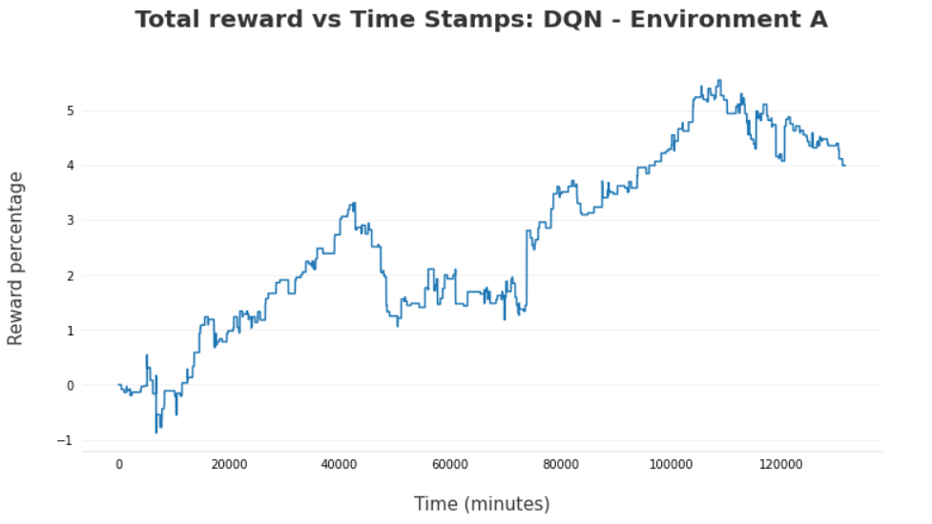
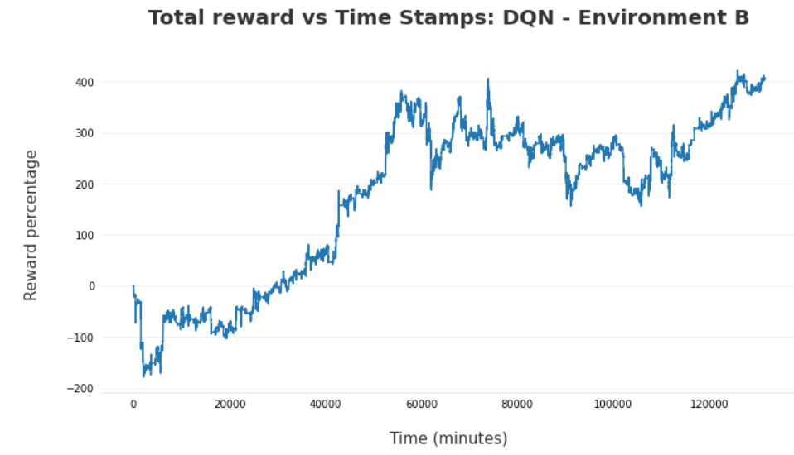
Results With the DQN Model

Slide 10
Results With the DQN Model
Analysis
Over the number of time steps, the agent was able to show a tendency to obtain positive reward percentages and absolute rewards.
For environment setup A: The model performs well. It does not go to negative percentage and ensures the net percentage increases as time steps increase. Maximum percentage return of over 5% is noted in the graph.
For environment setup B: The model does dive to negative rewards earlier but learns the trends and increases the reward as time steps increase.

Slide 11
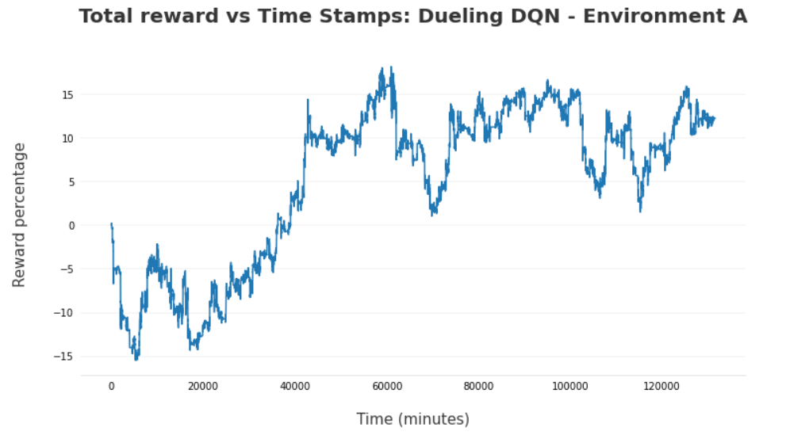
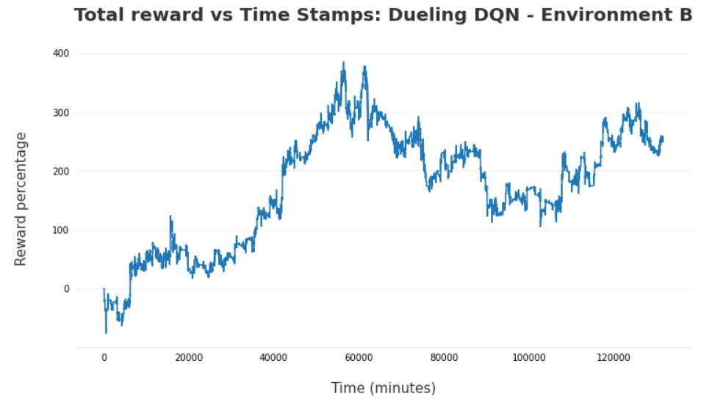
Results With the DDQN Model

Slide 12
Results With the DDQN Model
Analysis
Over the number of time steps, the agent was able to show a tendency to obtain positive reward percentages and absolute rewards with this model as well.
For environment setup A: The model performs well. Initially we observe loss percentages but the model catches up and increases. Maximum percentage return of over 15% is noted in the graph.
For environment setup B: The model does observes a general rise in the rewards obtained, however faces a local maxima and seems to have stuck. Performance drops and then is picked up again later but not par to the previous peak.
This model gave better results than DQN for Environment A but not B.

Slide 13
Result Comparison - - Environment A
We can see that Dueling DQN has outperformed the baseline model for Environment A.

Slide 14
Result Comparison - Environment B
However, the overall rising trend is better pursued by the baseline on environment B.

Slide 15
Thank you

Slide 16
Link to code repository:
References
Github
https://ieeexplore.ieee.org/document/9040728
https://towardsdatascience.com/dueling-deep-q-networks-81ffab672751
https://github.com/PacktPublishing/Deep-Reinforcement-Learning-Hands-On/tree/master/Chapter08/data

